Slide 1
Success and Music Genres - Quantifying the Evolution of Individual Scientific Impact
Michael Mandulak
CSCI-6250

Slide 2
Outline
Quantification of Individual Scientific Impact
  Random Impact Rule
  Q-model
Related works
  Mentorship in the music industry
  Productivity and success in the performing arts
Project Goals
  Quantification of Success in Music Genres
Data Collection and Statistics
Network Views
Results
  Genre Prediction
  Generation of Temporal Data
  Parameter Estimation and Correlation
Conclusions and Future Works

Slide 3
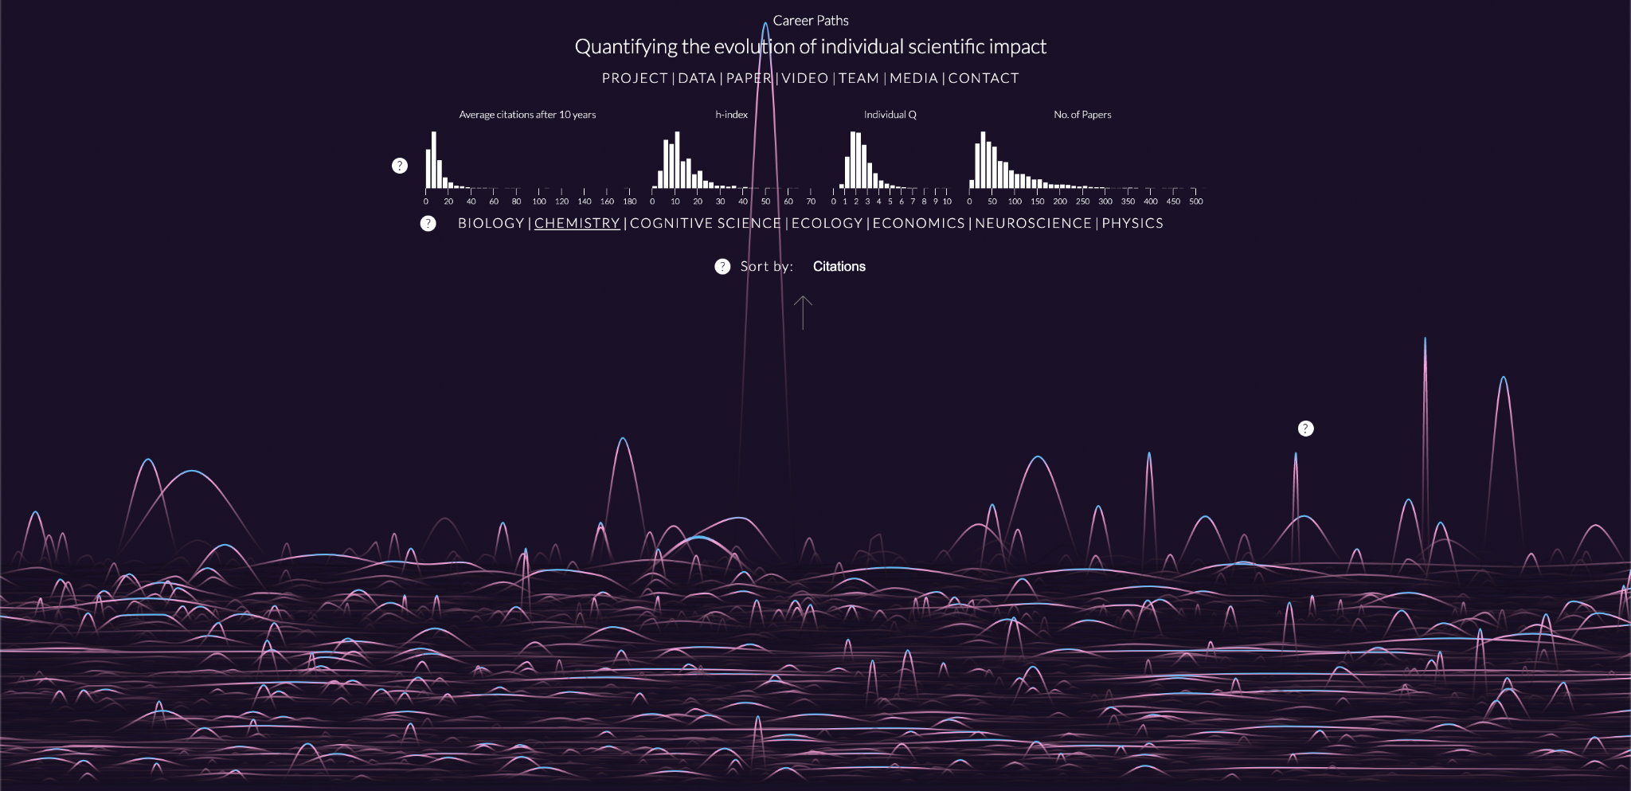
Research Focus
Study scientists’ impact on the field over careers
Quantify:
  What distinguishes scientists?
    Productivity (N)?
    Timing of publications?
    Luck?
  Change in impact - evolution

Slide 4
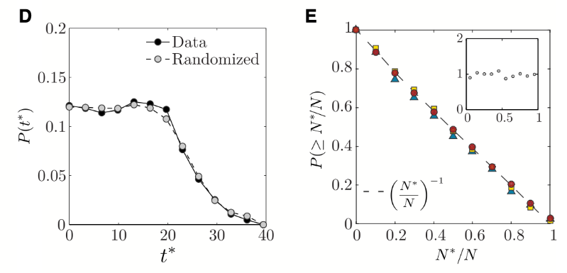
Methods Used
Time series of publications and citation numbers
Distribution of scientist’s top papers within their career
PCA and covariance of scientists’ citation statistics

Slide 5
Data Utilized
Two separate sets:
  American Physical Society (APS) Physical Review (1893-2010)
    236,000~ physicists publishing
  Google Scholar - Web of Science (WoS)
    515,000~ publications
    Biology, Chemistry, Cognitive Science, Ecology, Economics, Neuroscience
Results of 2900~ scientists:
  Consistently publish (5~ years)
  Long career (20 years)
  Solid baseline (10 publications)

Slide 6
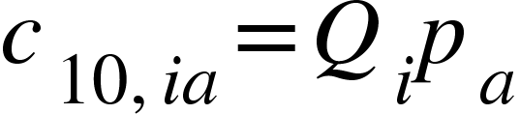
Conclusions
Random Impact Rule:
  Random distribution of impact throughout any scientist’s career
  Ignores time/order of publication
Q-Model:
  Number of citations 10 years after publication
  “Luck” factor, fairly constant and unique to the scientist
  Potential impact of paper a
Predictive measure of Q on productivity N

Slide 7
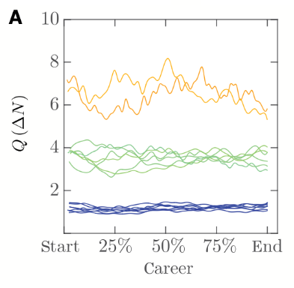
Takeaways
Q-enabled:
  Can predict success based on a known Q value
  Can generate synthetic publication sequences (Q and N)
  Can estimate Q from a set N₀ publications
Unknown nature of Q parameter
  Assumed intrinsic
Q is consistent throughout career

Slide 8
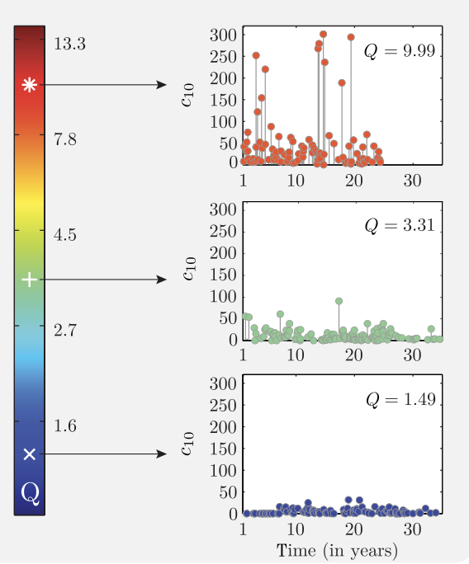
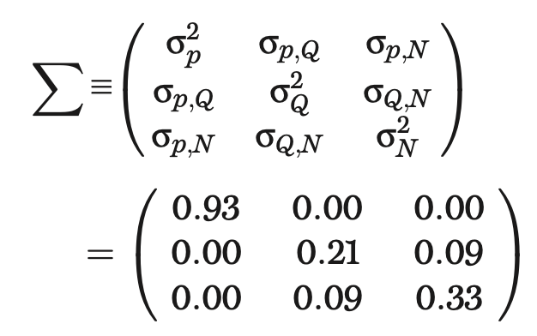
Takeaways (cont.)
Q and Productivity
  Can generate synthetic sequences of publications from Q and N
  Randomly draw potentials and assign impact

Slide 9
Related Works of Interest
Elites, communities and the limited benefits of mentorship in electronic music
  Janosov, M., Musciotto, F., Battiston, F., & Iñiguez, G.
  Studies individual vs. collaboration in achieving success in the music industry
  Mentorship shows positive results, does not directly lead to all-star development
Quantifying and predicting success in show business
  Williams, O. E., Lacasa, L., & Latora, V.
  Productivity is consistently higher in the beginning
  “Rich-get-richer”
  Career activity is unpredictable

Slide 10
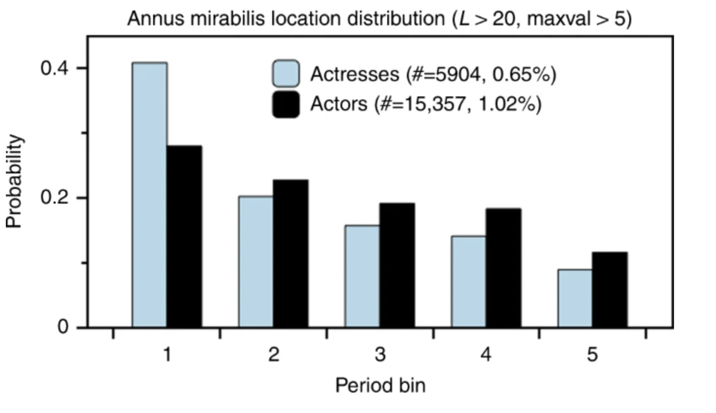
Related Works Takeaways
Similar methodologies
  Trend variance based on dataset utilized
  Trend per field? Industry?
Genre Problem
  Trend observed in all instances in the field?
  How specific can trends categorize?

Slide 11
Research Project Goals
Find trends
  Success based on genre?
  Quantification methods work outside of science?
Apply methods of scientific impact to music
  Q-model
  Predictive measures
  Sequence/data generation

Slide 12

Data Collection
Spotify Daily Top 200 Song Dataset
  January 2017 - Present
Extract artist lists from all songs
  Restrict to U.S.A.
Query APIs for extended data
  Spotify - Popularity, Genres, Top 10 songs
  Musicbrainz - Productivity

Slide 13
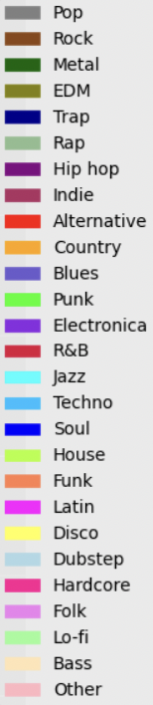
Genre Extraction
Generalized into 27 groups (most frequent)
  Each artist tagged by Spotify
Multiple tags per genre label
  Categorized with sequence similarity measures
Single binary vector per song
  Matches artist’s genre labels

Slide 14
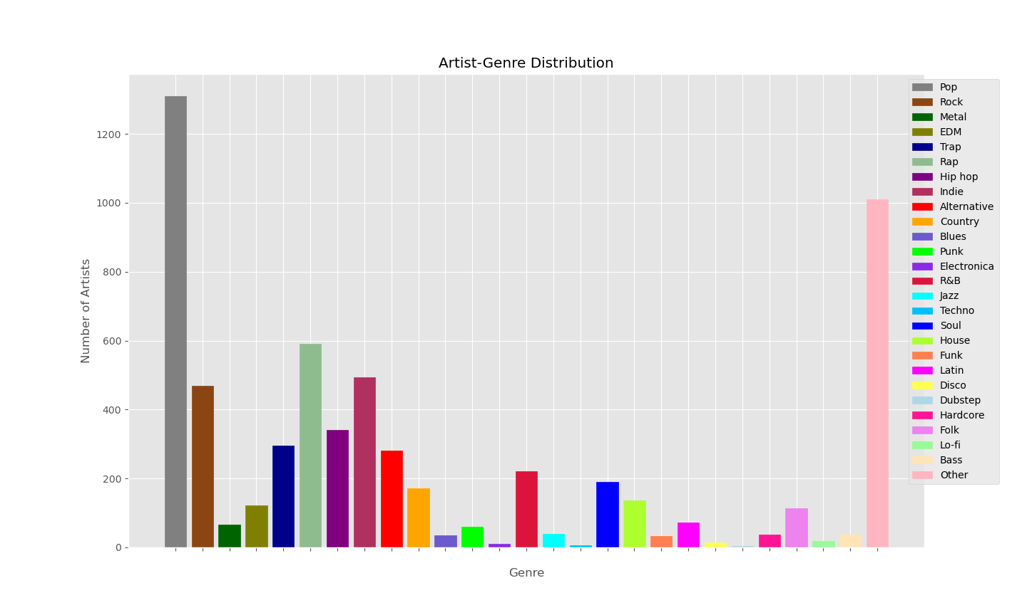
Number of Artists Per Genre (2363 Total)

Slide 15
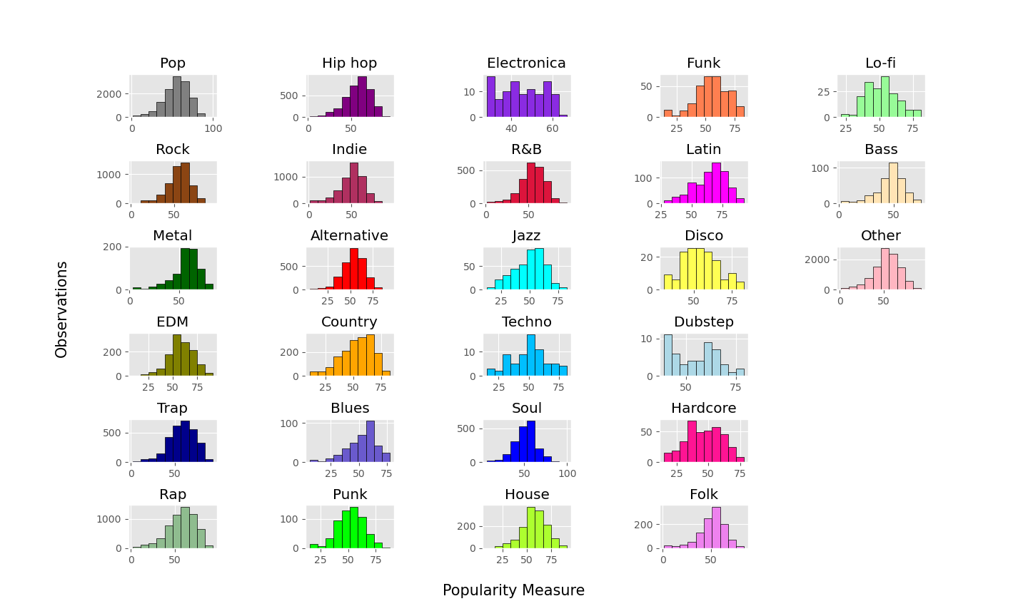
Popularity Values Per Genre

Slide 16
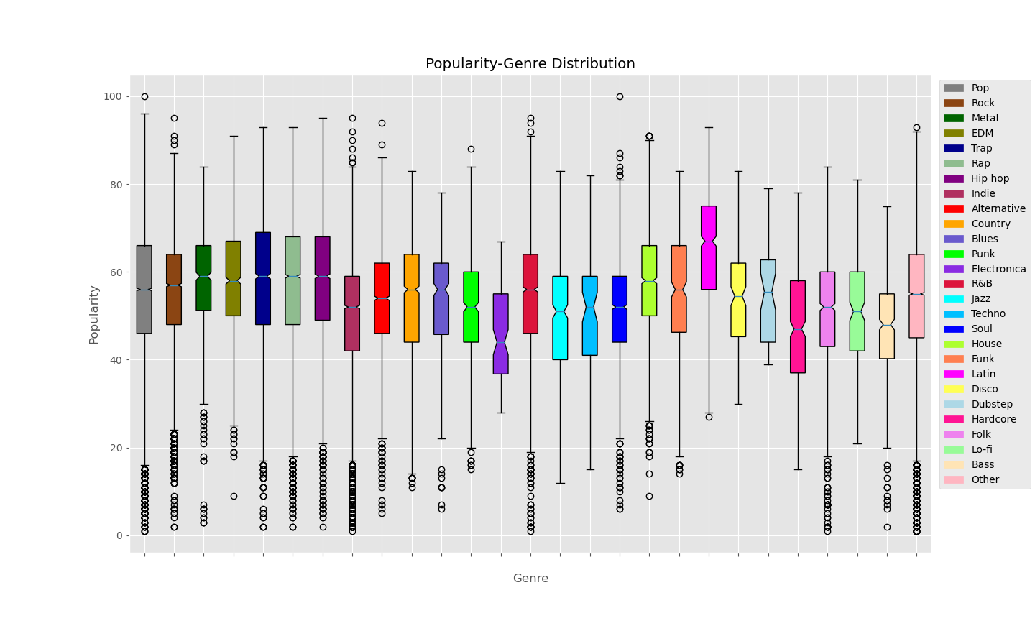
Popularity Values Per Genre

Slide 17
Data Utilization
Apply Q-model with Spotify Popularities (P_{s})
  Sequence of top 10 songs
  Generate potentials from truncated normal distribution
  Popularities bounded by top 10 list
  Scaled and unscaled variants
Genre prediction
“Fake” data generation and Network View

Slide 18
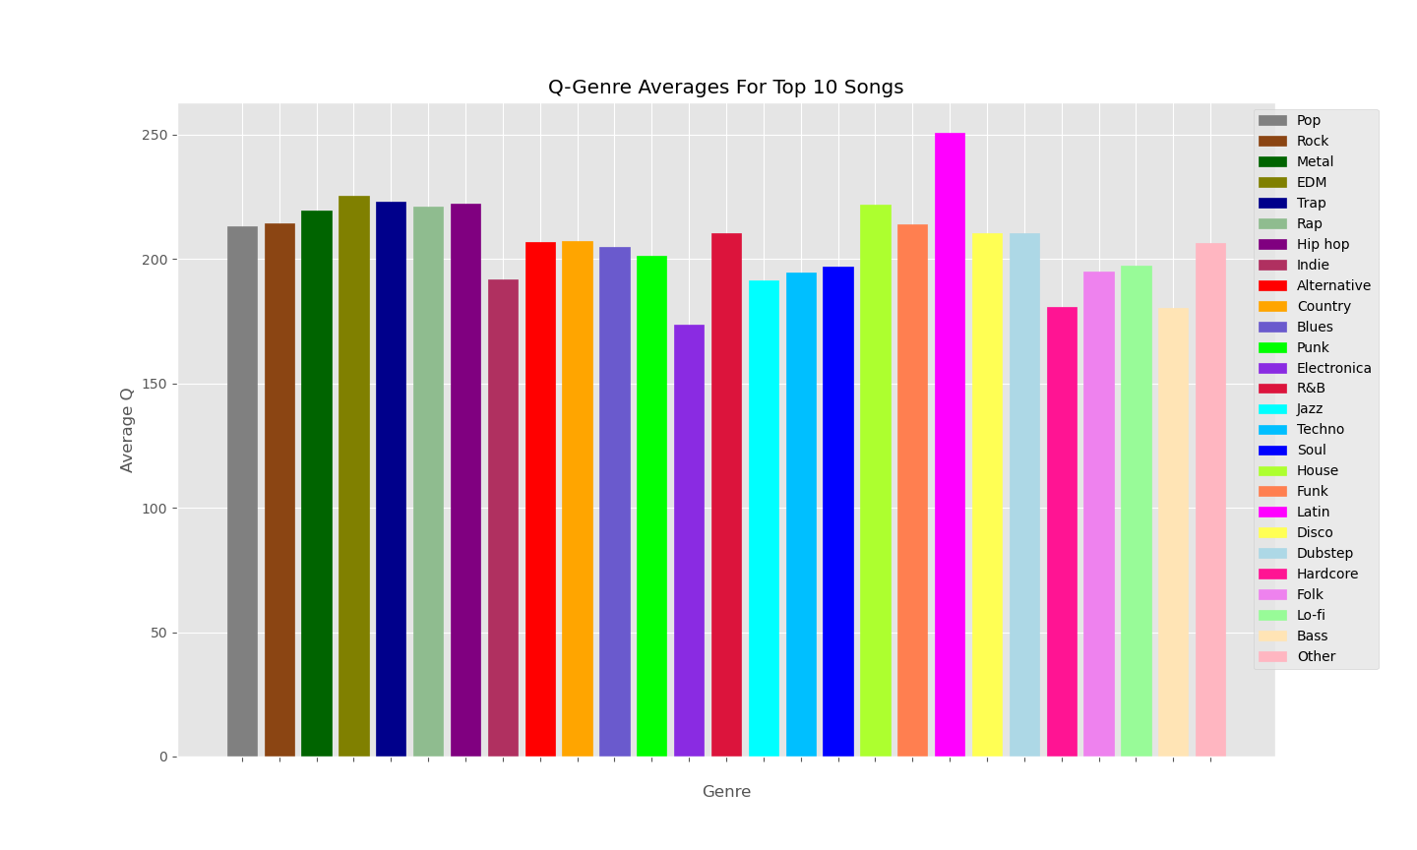
Average Q Values Per Genre

Slide 19
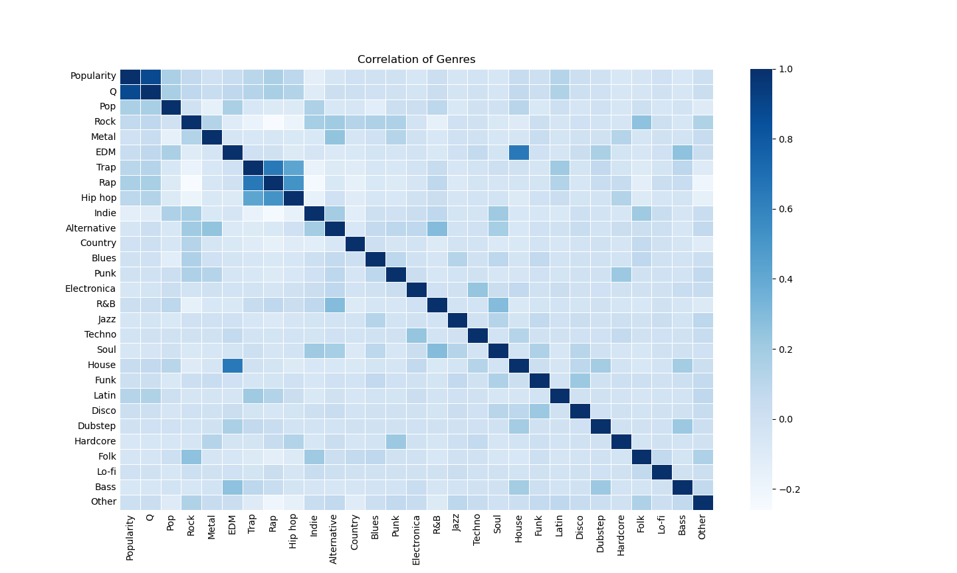
Correlation Matrix (Pearson)

Slide 20
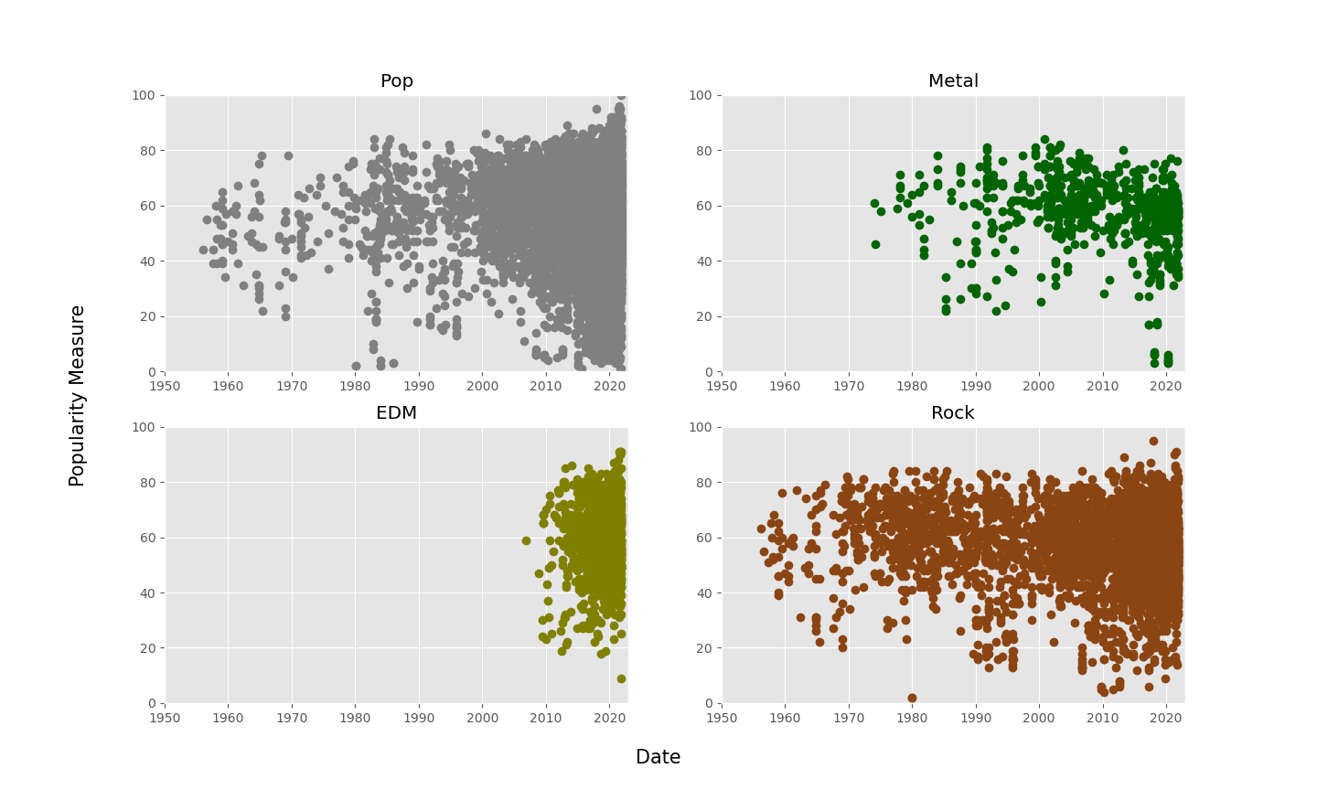
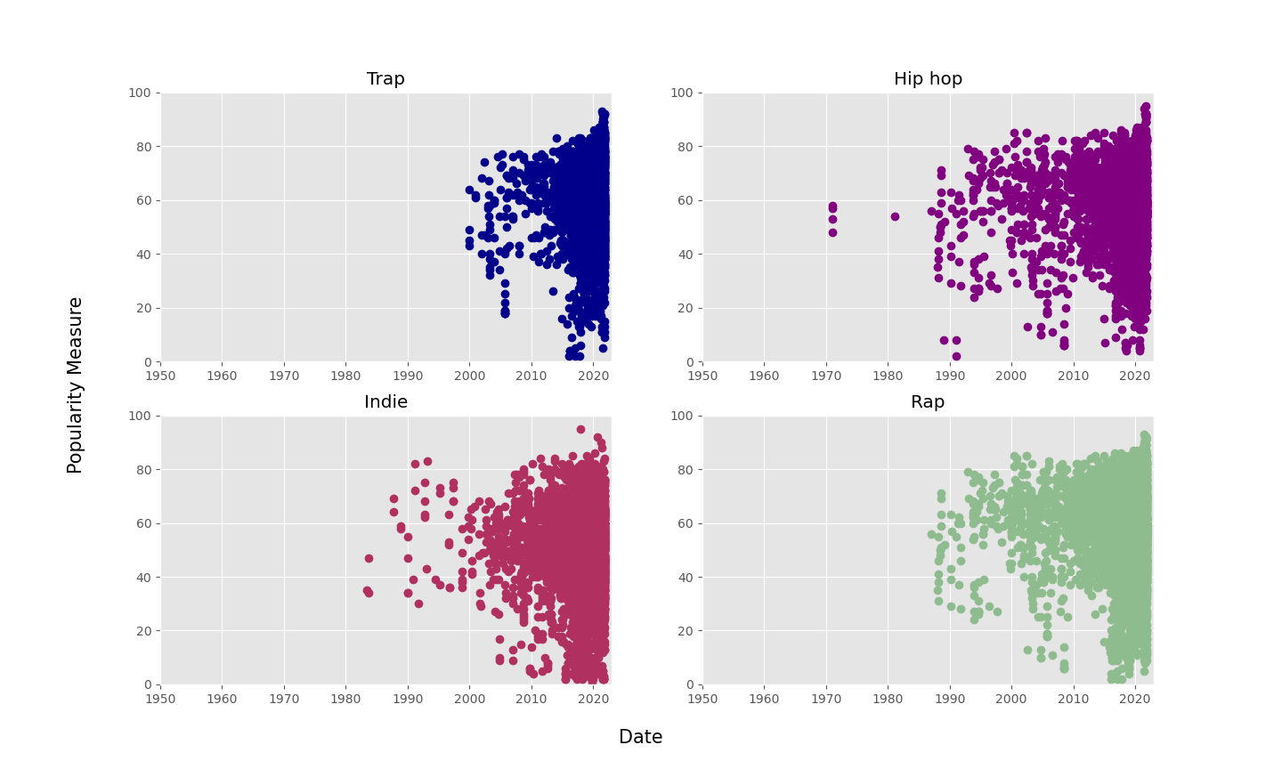
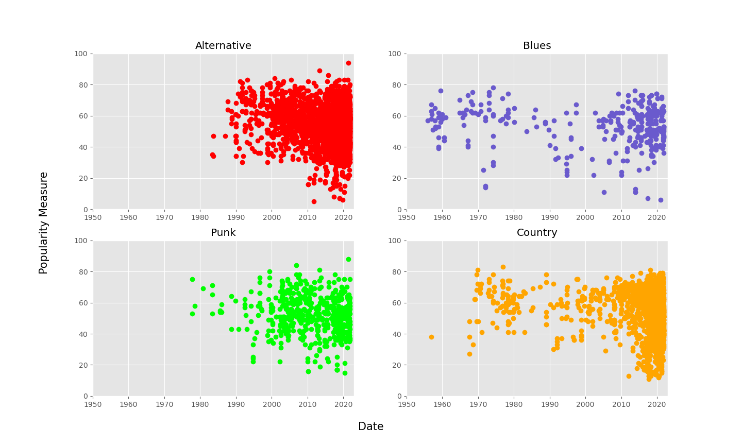
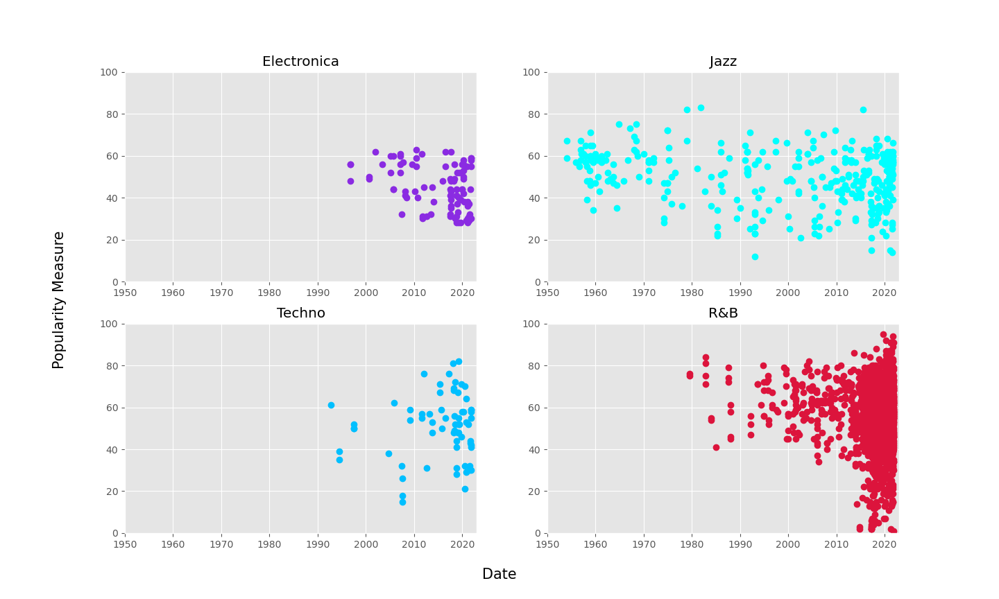
Temporal 1

Slide 21
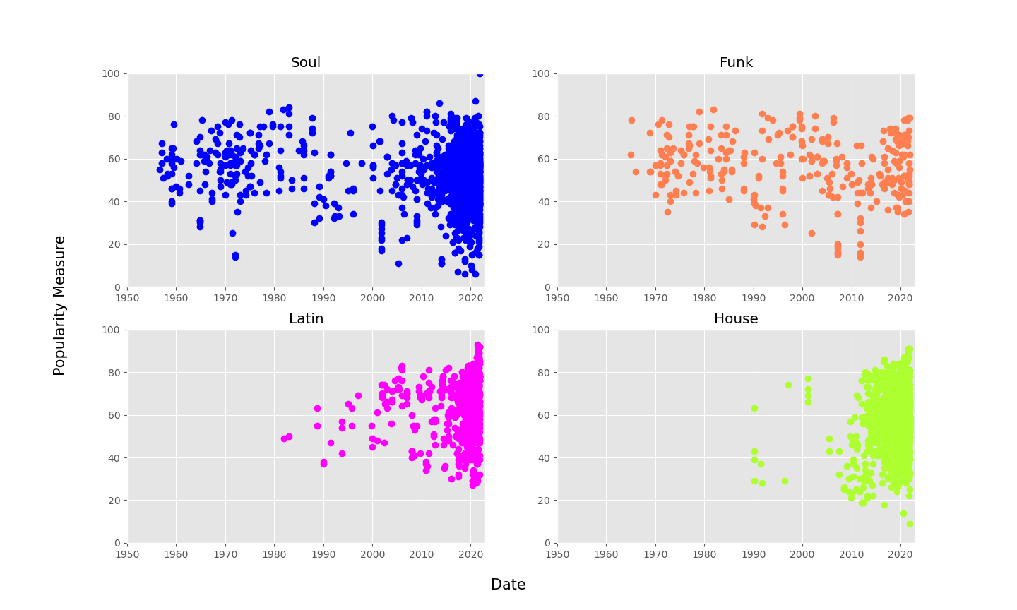
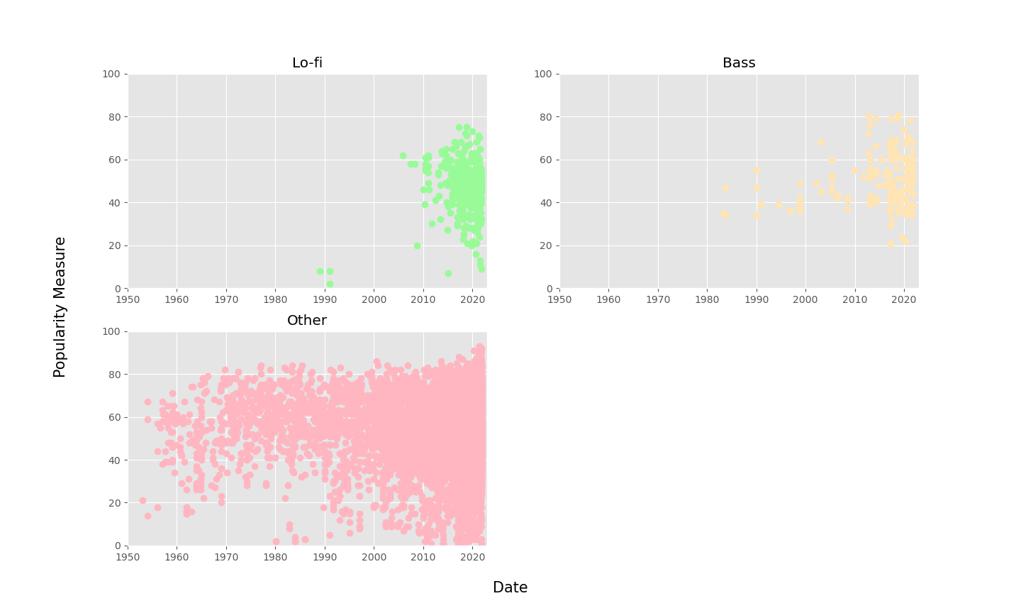
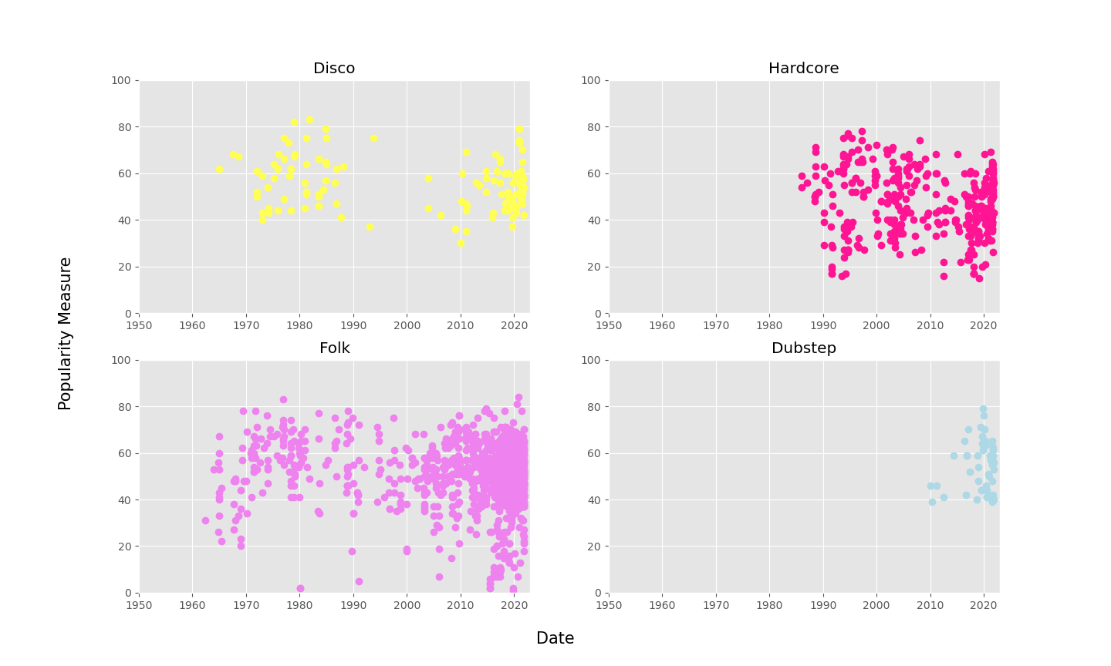
Temporal 2

Slide 22
Data Utilization
Apply Q-model with Spotify Popularities (P_{s})
Genre prediction
  Parameters: Q, N, Release Date, Popularity
  Prediction with randomized combinations of categorized genres
  Methods: SVM (flattened classifier), DT, k-NN
“Fake” data generation and Network View

Slide 23
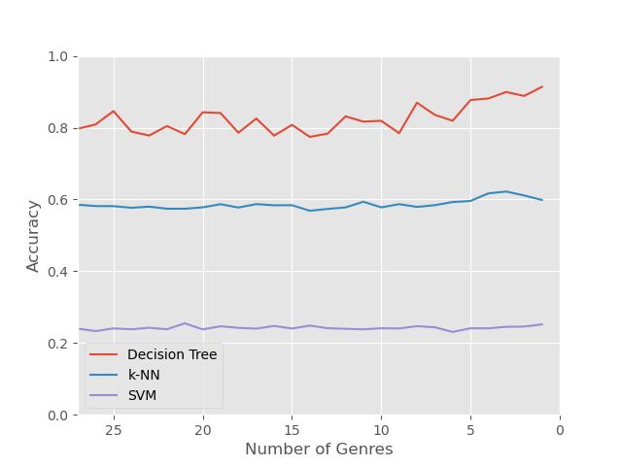
Genre Prediction
Parameters:
Q value
Release Date
Popularity Value
Productivity (N)

Slide 24
Data Utilization
Apply Q-model with Spotify Popularities (P_{s})
Genre prediction
“Fake” data generation and Network View
  Networks:
    Genre-based edges
    Popularity-banded edges (±5) - Top Limited
    Popularity-banded edges (±5) - Unlimited
  Re-evaluate Q values and apply to network

Slide 25
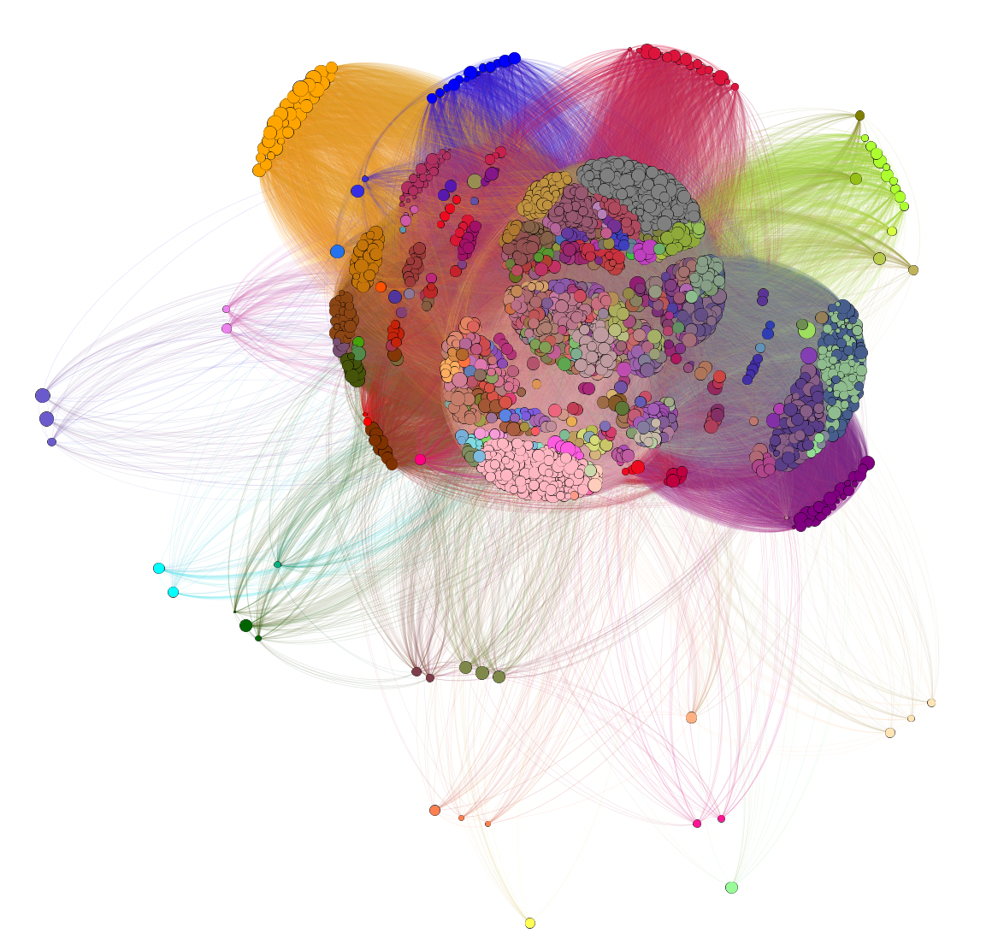
Network View of Genre-based Edges - Layout 1 (N: 2363, E:1528446)

Slide 26
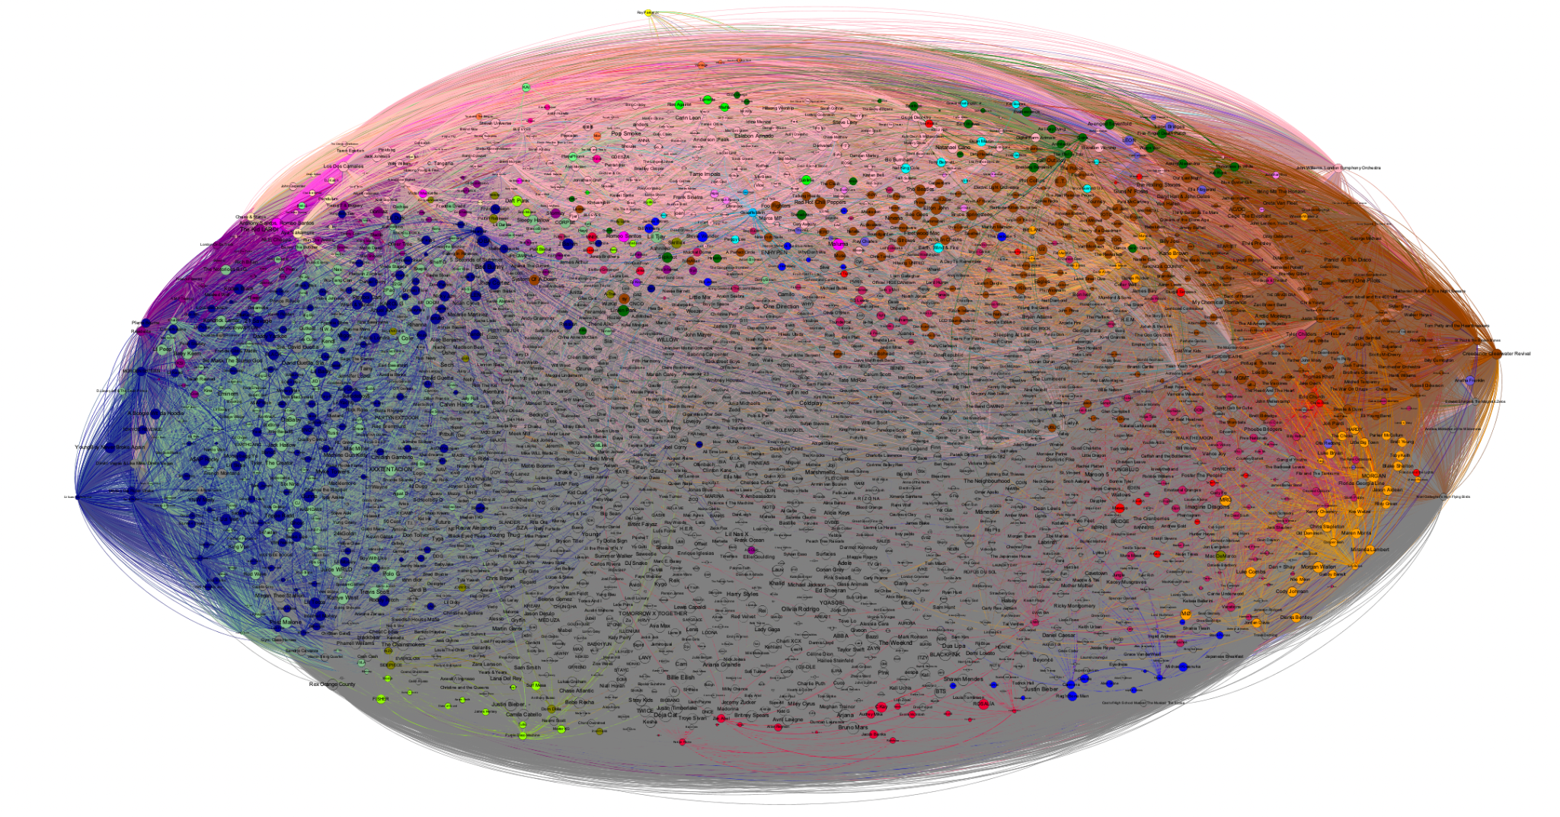
Network View of Genre-based Edges - Layout 2 (N: 2363, E:1528446)

Slide 27
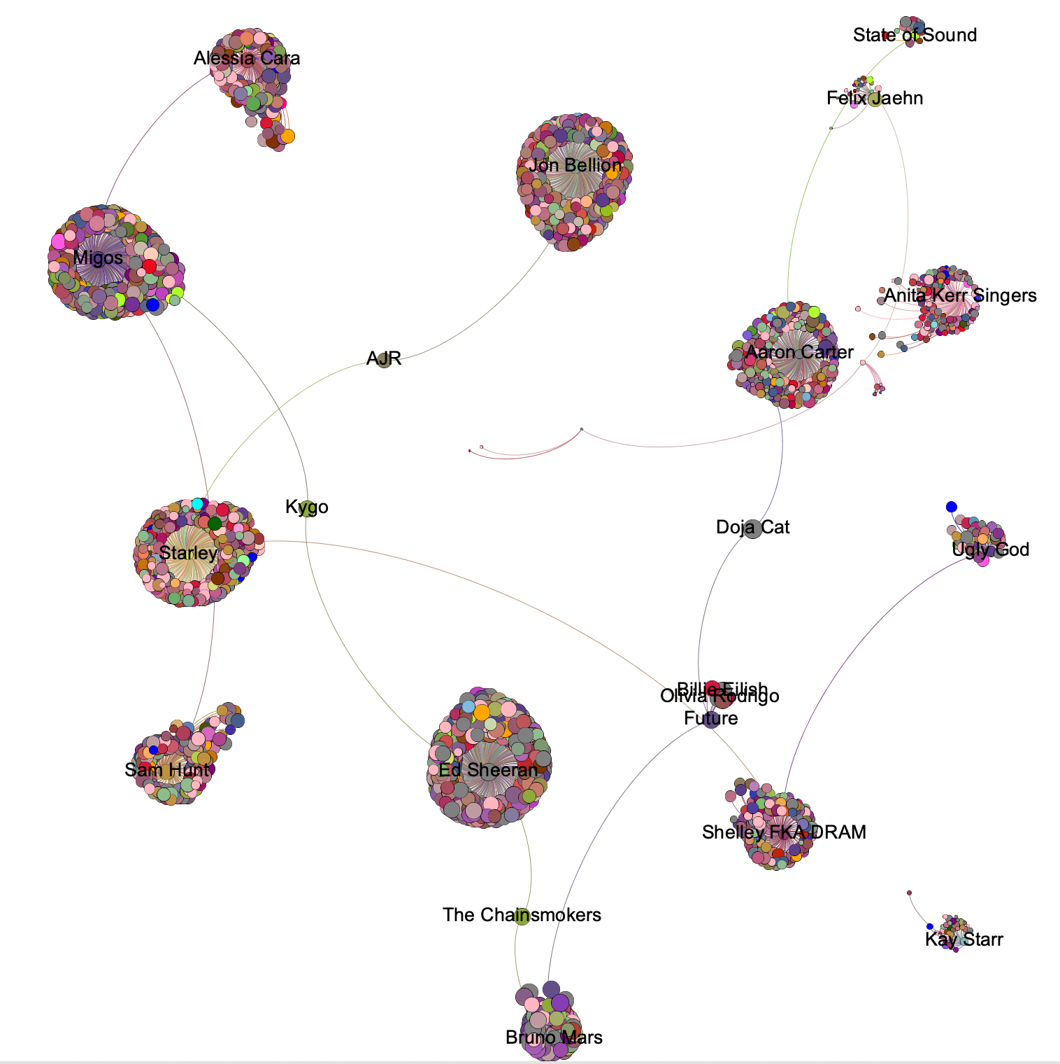
Network View of Popularity-banded Edges - Limited (N: 2363, E: 2356)

Slide 28
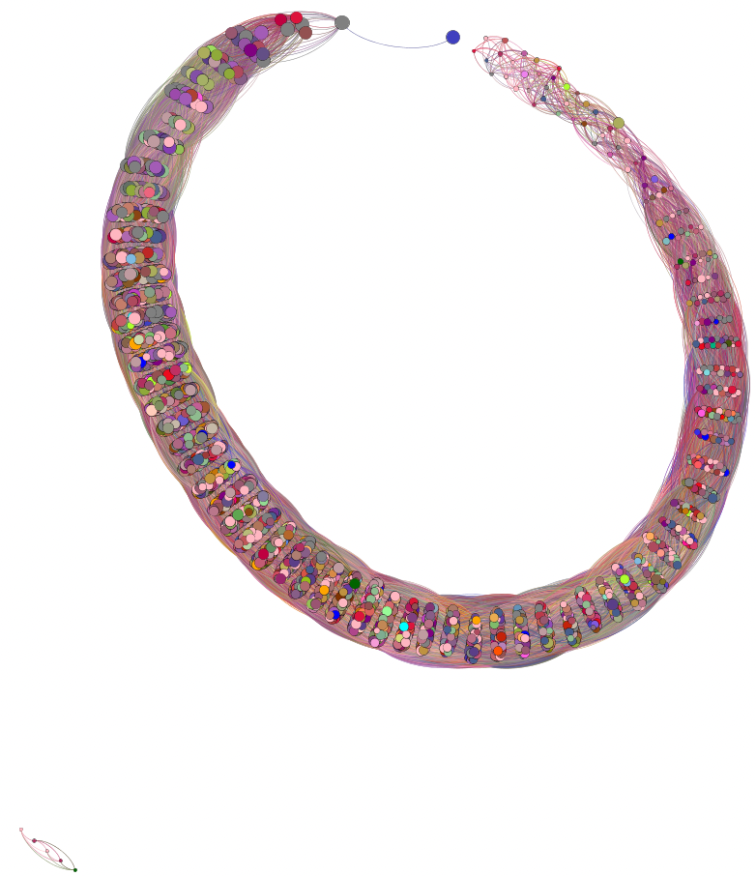
Network View of Popularity-banded Edges - Unlimited (N: 2363, E: 539457)

Slide 29
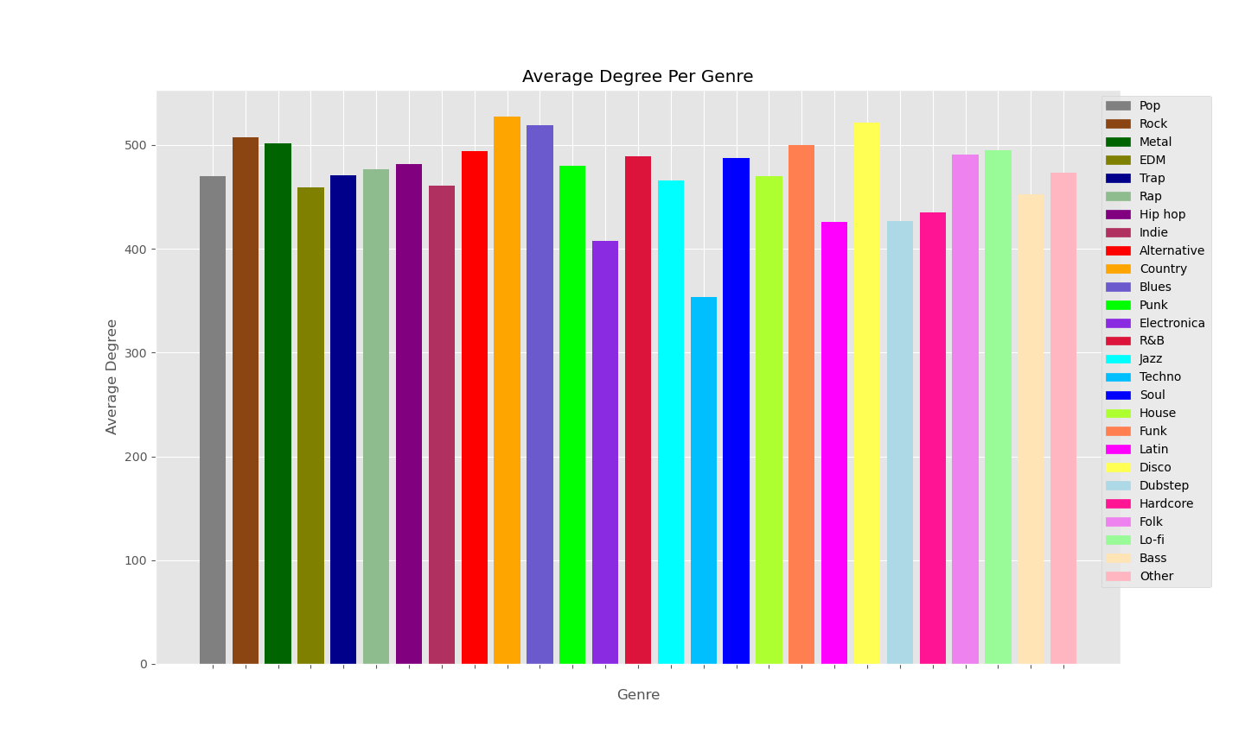
Average Degrees for Popularity-Banded Network - Unlimited (Average Overall Degree 457~)

Slide 30
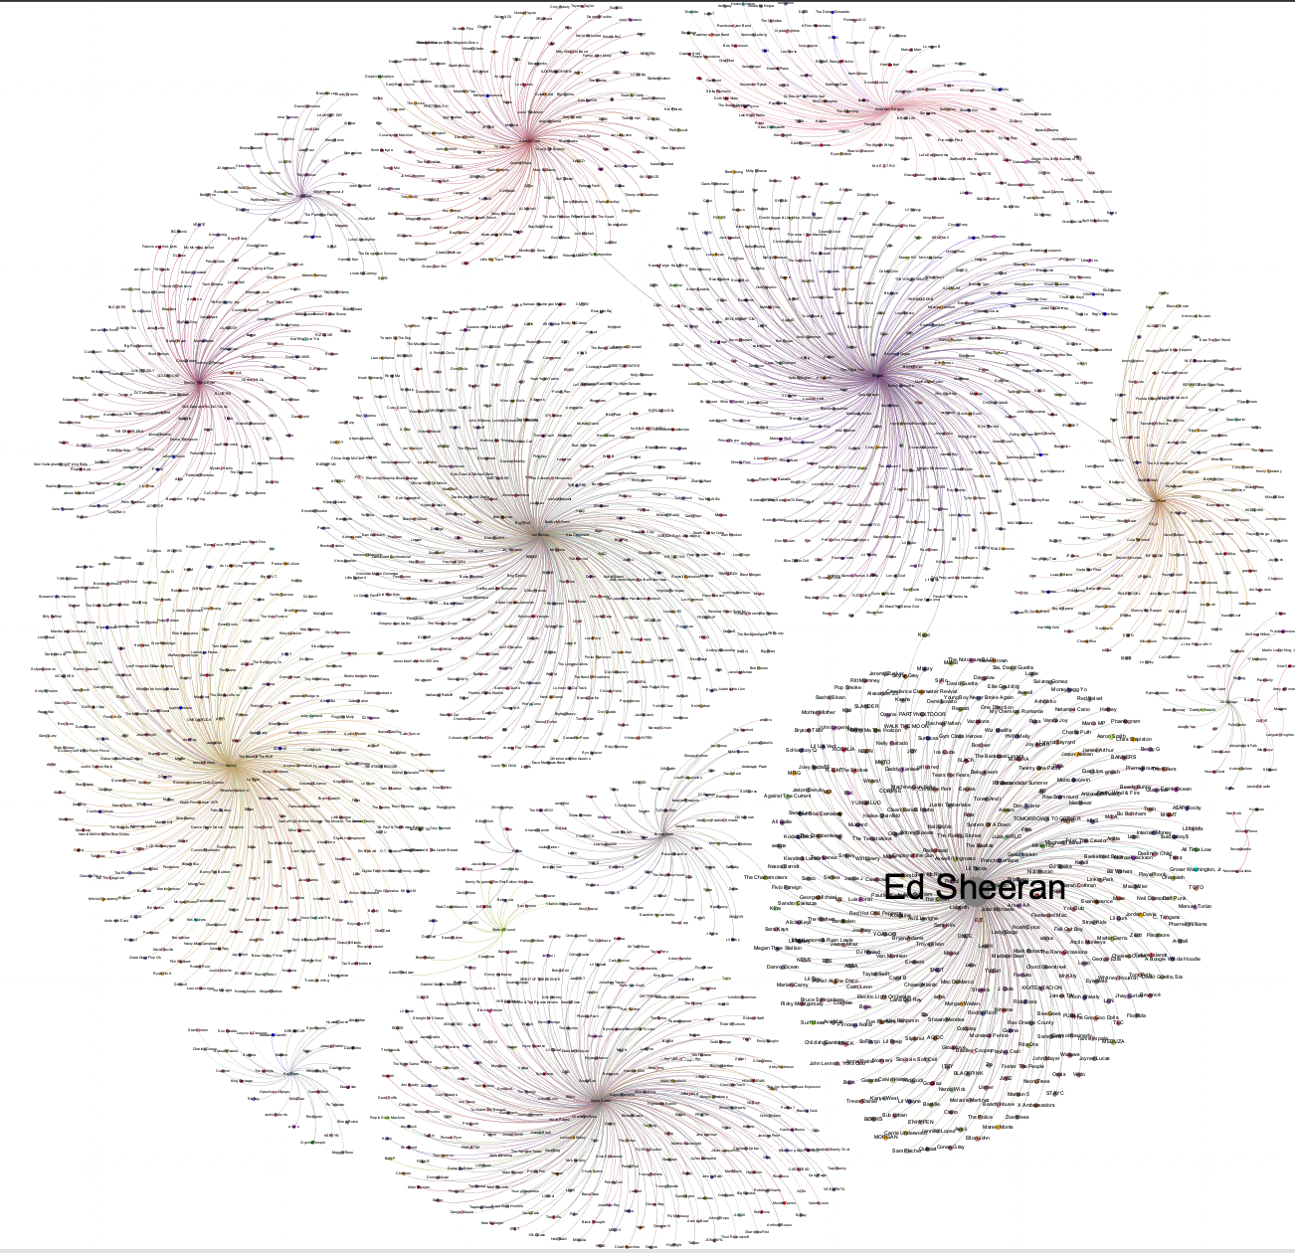
Network View of Popularity-banded Edges - EVC (N: 2363, E: 2356)

Slide 31
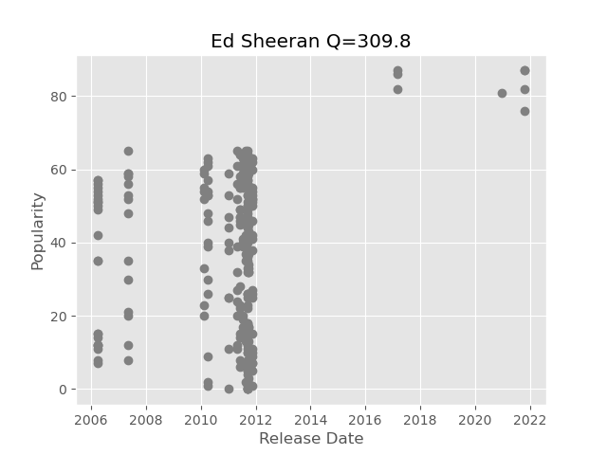
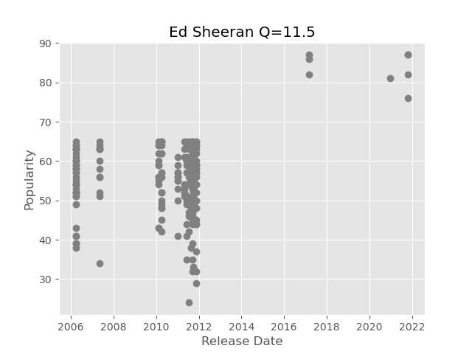
Q Scaling Based on Generated Data

Slide 32
Conclusions and Future Works
Conclusions:
  No clear correlation between genre and success
  Q-model seems to translate well (Spotify popularity robust?)
  Parameters effective for genre prediction
Future Works:
  Apply Q re-evaluation repeatedly and check network
  More data for accurate temporal results

Slide 33

Acknowledgements
& References
Questions?
Janosov, M., Musciotto, F., Battiston, F., & Iñiguez, G. (2020). Elites, communities and the limited benefits of mentorship in electronic music. Scientific reports, 10(1), 3136. https://doi.org/10.1038/s41598-020-60055-w
Sinatra, R., Wang, D., Deville, P., Song, C., & Barabási, A. L. (2016). Quantifying the evolution of individual scientific impact. Science (New York, N.Y.), 354(6312), aaf5239. https://doi.org/10.1126/science.aaf5239
Williams, O. E., Lacasa, L., & Latora, V. (2019). Quantifying and predicting success in show business. Nature communications, 10(1), 2256. https://doi.org/10.1038/s41467-019-10213-0
http://scienceofsuccess.barabasilab.com/
Michael Mandulak: mandum@rpi.edu

